Slide 1

Taiwan(Taichung district) gerrymandering observation
Current status: (Total :8)
DPP*5, KMT*3 (ignore other partisan votes)
Government re-arrange distribution in 2006 (11 districts to 5 + (x-1,500,000)/300,000 districts
Goal:
Re-arrange districts: 2nd district is weird now(connect to coast area and mountain area
Benefit to DPP: re-arrange district distribution to let DPP win
Benefit to KMT: re-arrange district distribution to let KMT win
Issues:
Hardly set extra variable to find the maximum legislator for one specific party

Slide 2
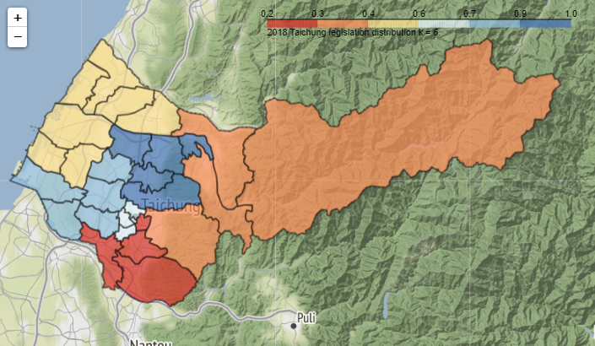
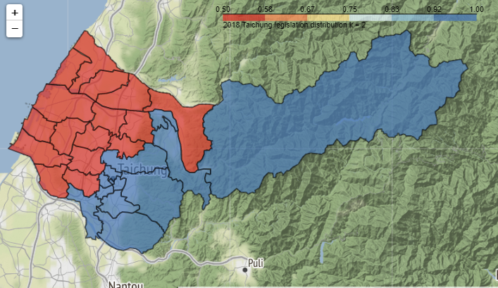
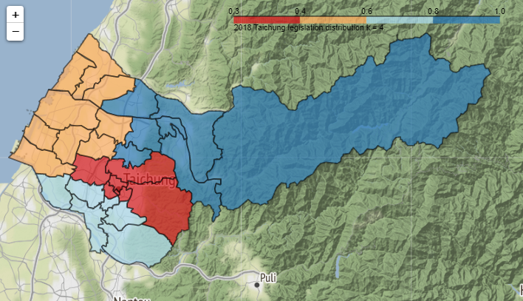
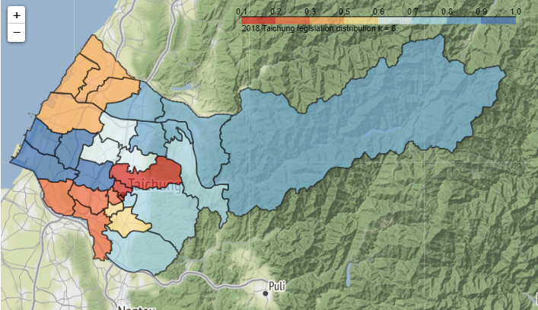
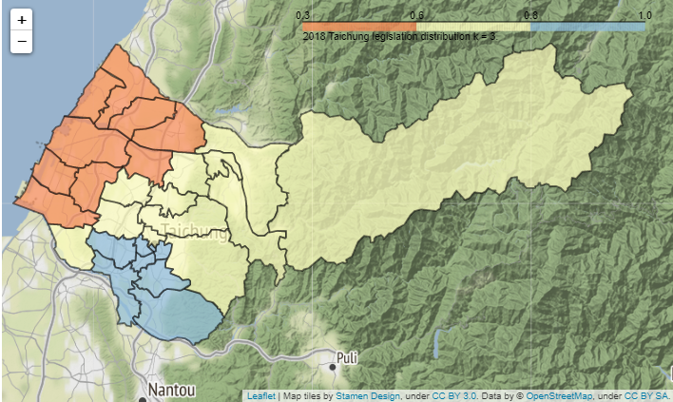
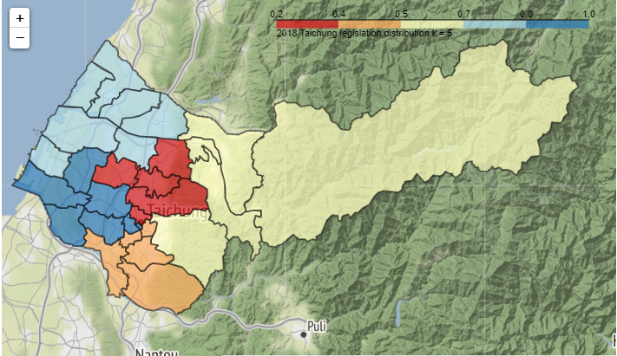
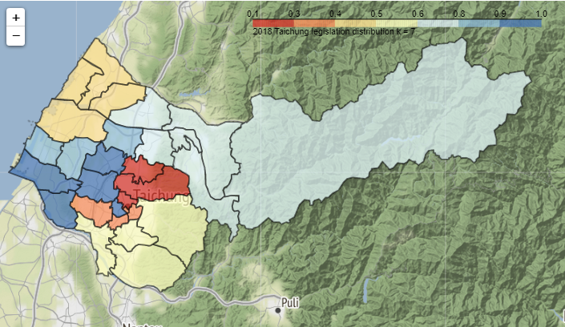
Rearranging district
Result
k= 6
k= 2
k= 4
k= 3
k= 7
k= 5
k= 8

Slide 3
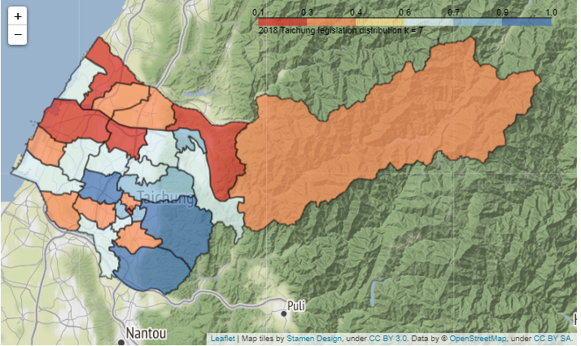
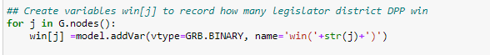
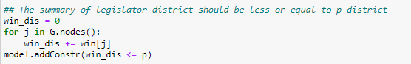
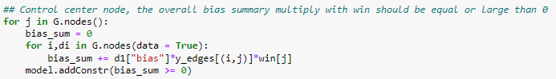

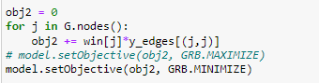
Adjacent areas→ connected edges
Issue1
Result
Setting one binary variable to accumulate how many legislation district one specific party win
Setting constraint: summary of this variables less than or equal to p(k district)
Setting constraint: the bias of each cluster will larger than or equal to 0
Setting objective function:
Maximize or minimize the summary of this variable
Weird! The max. and the min. have the same result

